Slide 1

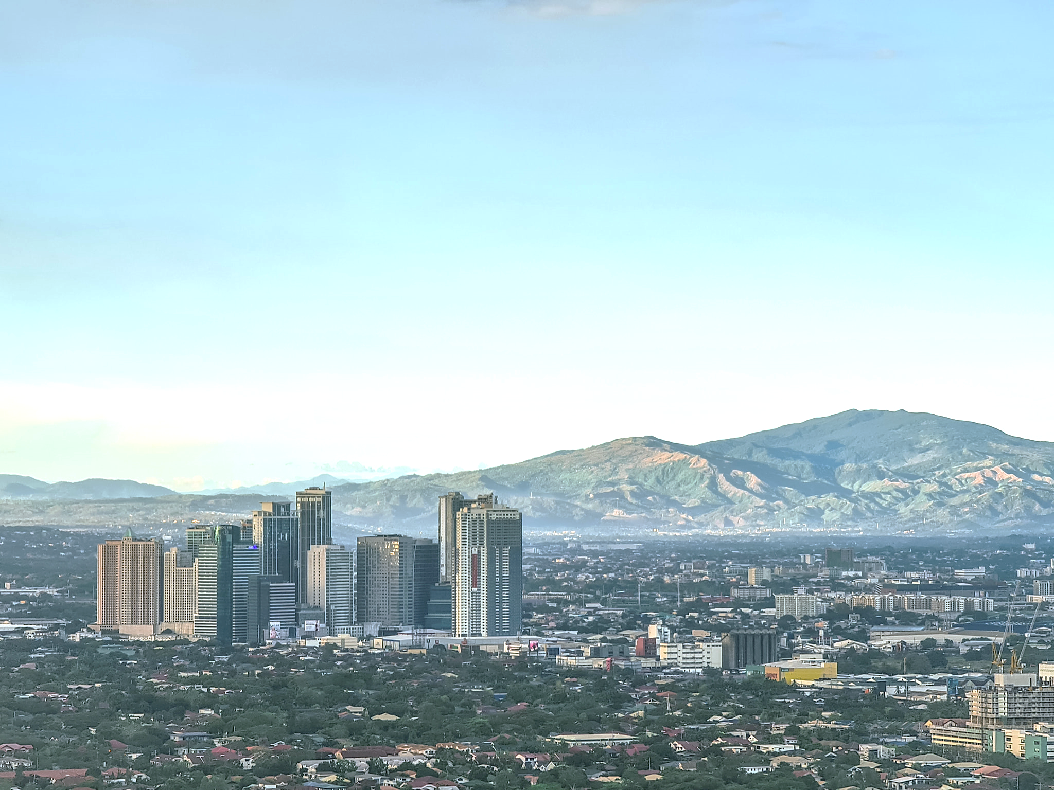
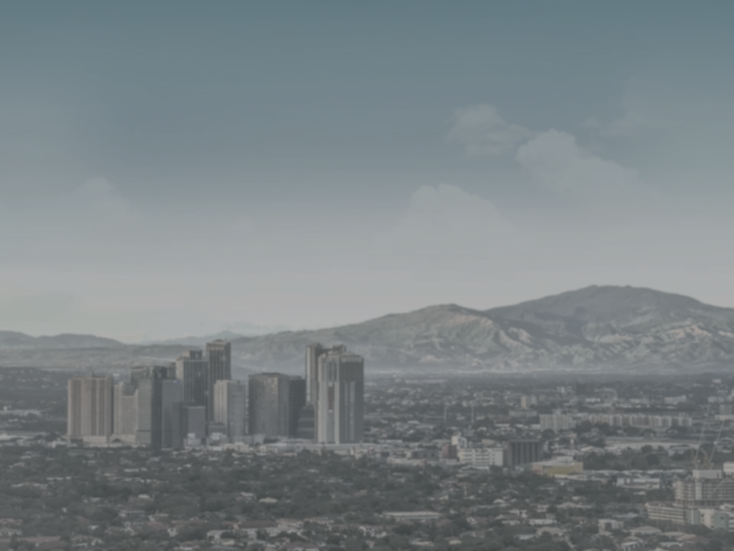
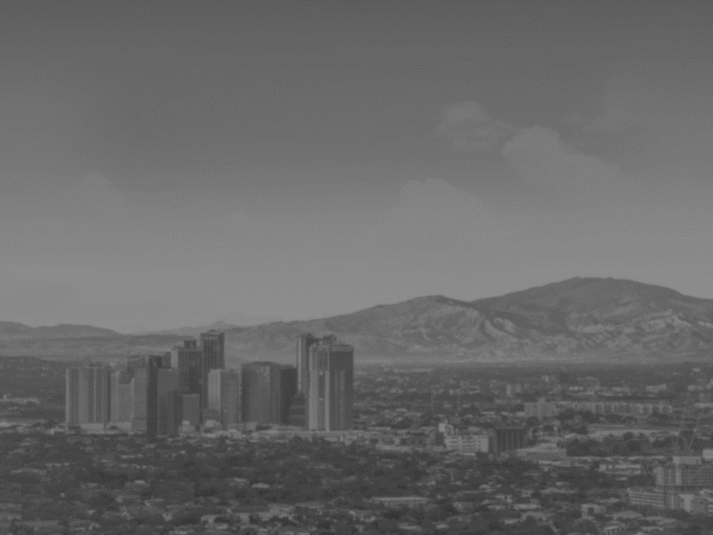
AIR QUALITY IMPROVEMENT DURING COVID-19 MANILA LOCKDOWN
ANNUAL AVERAGE FINE PARTICLE POLLUTION (PM2.5, in μg/m³) CONCENTRATION IN MANILA, PHILIPPINES
17.6
15.6
14.9
14.6
12.8
2018
2019
2020
2021
2022

Slide 4
AIR QUALITY IMPROVEMENT DURING COVID-19 MANILA LOCKDOWN
ANNUAL AVERAGE FINE PARTICLE POLLUTION (PM2.5, in μg/m³) CONCENTRATION IN MANILA, PHILIPPINES
2018
2019
2020
2021
2022

Slide 5
17.6
15.6
14.9
14.6
12.8

